Slide 1

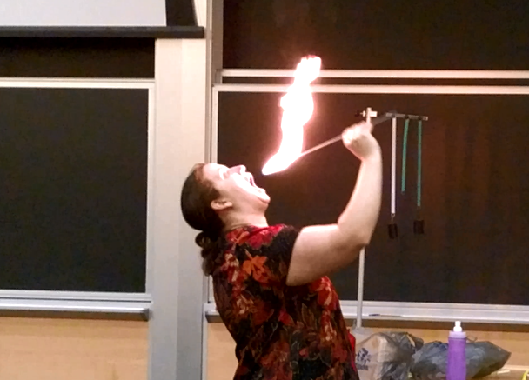
Fire Eating Demo
While I don’t encourage trying this, if you do decide to try this, here are some tips that may help prevent an accident. (I have burnt myself a few times even following!)
Breathe in before (prevents from: inhaling fire = bad)
Wet your lips (prevents from: burnt lips = bad)
Extinguish quickly (don’t want wick hot, burnt mouth = bad)
Pull long hair back (burning hair = really bad!)
Clothing: Synthetic fabrics are less likely to catch fire.
Notes:
Burning clothes = bad
Lots of things can go wrong, so if you do try this, make sure you have someone there to help you if things go bad.
Only put fuel on the end, otherwise you’ll burn your lips.
If time, change average energy to U

Slide 2
How is this possible?
Heat capacity = heat energy necessary to raise the temperature of a material. Used almost interchangeably with specific heat, which refers to the needed heat to adjust the temperature of a single unit of a substance’s mass by one degree.
Notes:
Often even use the same letter to refer to both.
When you talk about “heat capacity”, it is actually the heat needed for a substance’s temperature to change by one degree. This, therefore, shows that it is applicable to any type of matter. “Heat capacity” is the ratio of heat transfer “Q” to change in temperature “∆T.” In formulaic expression, it is C = Q / ∆T. In its SI unit notation, it uses units of energy / degree (energy per degree). It is expressed as the ratio of Joules (symbol “J” which stands for the value for energy) to Kelvin (symbol “K” which stands for the value of absolute temperature) C = J / K. In chemistry, however, they make use of molar heat capacity Cmol, which just adds the mol variable in the equation Cmol = J / mol . K.
On the other hand, “specific heat” sounds similar to heat capacity in terms of definition, but the former refers to the needed heat to adjust the temperature of a single unit of a substance’s mass by one degree. It makes use of energy / mass / degree units. C = J / kg . K. In here, the kg (kilogram) is the unit of mass included in the equation.
Read more: Difference Between Specific Heat and Heat Capacity | Difference Between http://www.differencebetween.net/science/difference-between-specific-heat-and-heat-capacity/#ixzz4v7FOiCY6

Slide 3
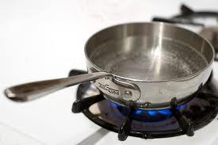
Some things are easier to heat
Can you think of examples?
More water in the pot needs longer time to boil
Alcohol/saltwater needs less energy to heat it than water
Transfer of energy (Q - heat) is proportional to the change in temperature (ΔT) x mass (m) of material x C
  Q = m C(T) ΔT
C called the specific heat of a material
  C_{water} = 4190 J/(kg K) - very difficult to heat
  C_{ice} = 2090 J/(kg K)
  C_{mercury} = 138 J/(kg K) - very easy to heat (thermometers)
  C_{ethanol} = 2428 J/(kg K) – much easier than water
How to calculate C?

Slide 4
Lattice Vibrational Contribution to the Heat Capacity
The thermal energy is the dominant contribution to the heat capacity in most solids.
In non-magnetic insulators, it is the only contribution.
Some other contributions:
Conduction Electrons in metals & semiconductors (will discuss later).
The magnetic ordering in magnetic materials.

Slide 5
First Classical Theory of Heat Capacity
(too simple, but a good start)
When the solid is heated, the atoms vibrate around their sites like harmonic oscillators.
The average energy for a 1D oscillator is ½ k_{B}T. (Boltzmann const.)
Therefore, the average energy per atom, regarded as a 3D oscillator, is 3/2 k_{B}T, and consequently the total energy is 3/2 Nk_{B}T where N is the number of atoms.
Differentiation w.r.t temperature gives heat capacity of 3/2 N k_{B} (predicts energy/atom is constant)
Notes:
This is sometimes written in terms of R, the gas constant.
R = Avogadro's constant times Boltzmann’s constant

Slide 6
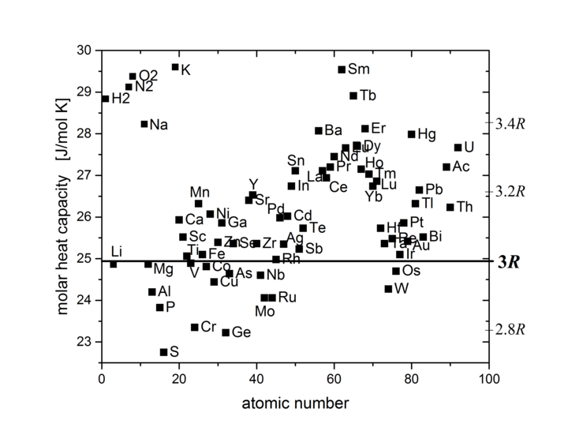
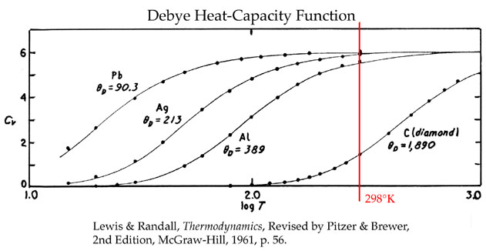
Classical Specific Heat (Spring Model)
Dulong-Petit law (1819) states that specific heat of a given number of atoms is independent of temperature and the material. Approximately true for high temperatures; but not for low temps.
Specific heat tends to classical value at high temperatures.
Notes:
Keep in mind that most measurements were done at room temperature or by heating at that time.
Top figure: Molar heat capacity of most elements at 25 °C is in the range between 2.8 R and 3.4 R: Plot as a function of atomic number with a y range from 22.5 to 30 J/mol K. - Wikipedia

Slide 7
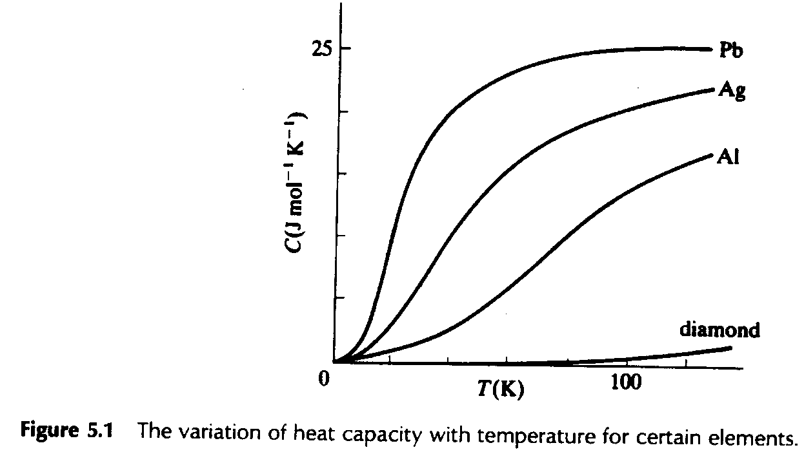
Classical Specific Heat (Spring Model)
Dulong-Petit law (1819) states that specific heat of a given number of atoms is independent of temperature and the material. Approximately true for high temperatures; but not for low temps.
At low T quantum phenomena are important and must be taken into account.
Specific heat tends to classical value at high temperatures.
Notes:
Keep in mind that most measurements were done at room temperature or by heating at that time.

Slide 8
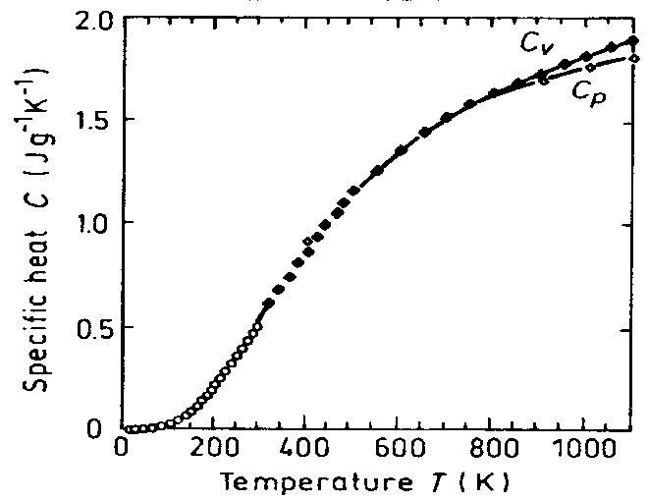
Two types of specific heat: C_{p} vs C_{v}
Specific heat under constant pressure or volume
Which variable are you more likely to control?
In solids, C_{p} and C_{v} are pretty close.
Diamond
Notes:
Diamond
Pressure hard to control in the real world. However, we often constraint the volume of materials by putting them in stuff.
Drop chemical potential for bosons, comes from the conservation of particles which is not required for bosons. (why did I put this note here? Later?)

Slide 9
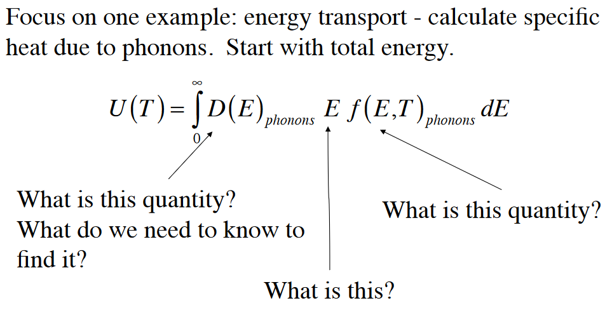
To be thorough need to find the total energy of the phonons U,
then take dU/dT to find C.
How to find U?
Let’s learn how to get these!
Notes:
E is phonon energy

Slide 10
Thermal Energy & Heat Capacity
Quantum Model
According to Quantum Mechanics if a particle is constrained;
the energy of the particle can only have special discrete energy values.
it cannot increase infinitely from one value to another.
it has to go up in steps (here: steps of the phonon energy)

Slide 11
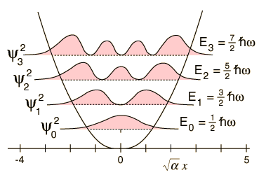

Treating Phonons like QM Oscillator
Einstein Model = Heat capacity C can be found by differentiating the QM average phonon energy
$$U=\sum_{n}{P_{n}}ε_{n}$$
The energy of a harmonic oscillator and hence of a lattice mode of angular frequency ω at temperature T
Energy of a single oscillator
What happens to U as the temperature increases?
Heat capacity is just dU/dT, need in terms of T.
The probability of the oscillator being in this level as given by the Boltzman factor
Notes:
Compare to square well. Are the energy levels spaced like this for harmonic well? No, a harmonic well has evenly spaced levels, as is the requirement discussed on the last slide.
n is an integer and is the excitation number of the harmonic state
In undergrad version of this class: ask how many have seen this before?
Write on board the Boltzman factor for this energy (leads into next slide) and then the total energy
If you’ve had quantum mechanics, you will have seen this already. If not, you can believe me that when you use a harmonic well instead of a square well, this is the energy levels you end up getting.

Slide 12
← Seen before?
Notes:
The canonical partition function. A partition function describes the statistical properties of a system in thermodynamic equilibrium
Ideal to get rid of the summation if possible
Also ask dz/dT, from first introduction of z

Slide 13
← Seen before?
Partition function
(describes the statistical properties of a system in equilibrium)
Can you think of a trick to simplify this?
Notes:
The canonical partition function. A partition function describes the statistical properties of a system in thermodynamic equilibrium
Ideal to get rid of the summation if possible
Also ask dz/dT, from first introduction of z

Slide 14
← Seen before?
Partition function
(describes the statistical properties of a system in equilibrium)
Can you think of a trick to simplify this?
Notes:
The canonical partition function. A partition function describes the statistical properties of a system in thermodynamic equilibrium
Ideal to get rid of the summation if possible
Also ask dz/dT, from first introduction of z

Slide 15
← Seen before?
Partition function
(describes the statistical properties of a system in equilibrium)
Can you think of a trick to simplify this?
According to the Binomial expansion for x«1 where
Notes:
The canonical partition function. A partition function describes the statistical properties of a system in thermodynamic equilibrium
Ideal to get rid of the summation if possible
Also ask dz/dT, from first introduction of z

Slide 16
← Seen before?
Partition function
(describes the statistical properties of a system in equilibrium)
Can you think of a trick to simplify this?
← Will need soon
According to the Binomial expansion for x«1 where
Notes:
The canonical partition function. A partition function describes the statistical properties of a system in thermodynamic equilibrium
Ideal to get rid of the summation if possible
Also ask dz/dT, from first introduction of z

Slide 17
← Seen before?
Partition function
(describes the statistical properties of a system in equilibrium)
What is dz/dT?
(on board)
Can you think of a trick to simplify this?
← Will need soon
According to the Binomial expansion for x«1 where
Notes:
The canonical partition function. A partition function describes the statistical properties of a system in thermodynamic equilibrium
Ideal to get rid of the summation if possible
Also ask dz/dT, from first introduction of z

Slide 18

Can be written as:
Notes:
If you use the original Z in terms of n+ ½ then it’s easy to see the numerator is just dz/dT

Slide 19
Can be written as:
Notes:
If you use the original Z in terms of n+ ½ then it’s easy to see the numerator is just dz/dT

Slide 20
Can be written as:
Notes:
If you use the original Z in terms of n+ ½ then it’s easy to see the numerator is just dz/dT

Slide 21
Can be written as:
Notes:
If you use the original Z in terms of n+ ½ then it’s easy to see the numerator is just dz/dT

Slide 22
Can be written as:
Notes:
If you use the original Z in terms of n+ ½ then it’s easy to see the numerator is just dz/dT

Slide 23
Can be written as:
Notes:
Bring the exponent term to the bottom. One of the terms becomes one

Slide 24
Can be written as:
Finally, the
result is
Notes:
If you use the original Z in terms of n+ ½ then it’s easy to see the numerator is just dz/dT

Slide 25
This is the Mean Phonon Energy. The first term in the above equation is the zero-point energy. Even at 0 K atoms vibrate in the crystal.
The number of phonons is given by the Bose-Einstein distribution as
Planck distribution =
(number of phonons) x (energy of phonon) = (second term in )
The second term in the mean energy is the phonon contribution to the thermal energy (since constant goes away with derivative).

Slide 26
Mean energy of a harmonic oscillator as a function of T
Low Temperature Limit
What happens to exponential term?
Since exponential term gets bigger
Zero Point Energy

Slide 27
Mean energy of a harmonic oscillator as a function of T
High Temperature Limit
<<
Notes:
Ask: does this look like our phonon energy bands? No.

Slide 28
Mean energy of a harmonic oscillator as a function of T
Taylor exp.
High Temperature Limit
<<
Notes:
Ask: does this look like our phonon energy bands? No.

Slide 29
Mean energy of a harmonic oscillator as a function of T
High Temperature Limit
<<
Notes:
Ask: does this look like our phonon energy bands? No.

Slide 30
Mean energy of a harmonic oscillator as a function of T
High Temperature Limit
<<
Notes:
Ask: does this look like our phonon energy bands? No.

Slide 31
Mean energy of a harmonic oscillator as a function of T
High Temperature Limit
<<
Notice that is the thermal energy of the classical harmonic oscillator in this high temperature limit.
Notes:
Ask: does this look like our phonon energy bands? No.

Slide 32
Mean energy of a harmonic oscillator as a function of T
High Temperature Limit
<<
is assumed independent of frequency of oscillation by the Einstein method in this limit.
Notice that is the thermal energy of the classical harmonic oscillator in this high temperature limit.
Notes:
Ask: does this look like our phonon energy bands? No.

Slide 33
Heat Capacity C (Einstein Model)
Heat capacity C can be found by differentiating the average phonon energy
Notes:
The derivative of ½ hbar omega is zero, so nothing from the first term

Slide 34
Heat Capacity C (Einstein Model)
Heat capacity C can be found by differentiating the average phonon energy
Notes:
The derivative of ½ hbar omega is zero, so nothing from the first term

Slide 35
Heat Capacity C (Einstein Model)
Heat capacity C can be found by differentiating the average phonon energy
Let
B
Notes:
The derivative of ½ hbar omega is zero, so nothing from the first term

Slide 36
Heat Capacity C (Einstein Model)
Heat capacity C can be found by differentiating the average phonon energy
Let
B
Notes:
The derivative of ½ hbar omega is zero, so nothing from the first term

Slide 37
where
B
C_{v}= dε /dT
Specific heat in this approximation vanishes exponentially at low T and tends to classical value at high temperatures.

Slide 38
where
B
C_{v}= dε /dT
Specific heat in this approximation vanishes exponentially at low T and tends to classical value at high temperatures.
These features are common to all quantum systems; the energy tends to the zero-point-energy at low T and to the classical value at high T.

Slide 39
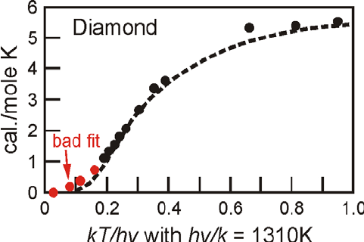
Einstein Model Fails at Low Temp
Einstein’s model also gave a much better fit for medium temperatures, but the temperature dependence near T= 0 still did not agree with experiment. Why?
C_{V}
Notes:
Einstein treated omega as a constant, but we’ve learned it’s not.

Slide 40
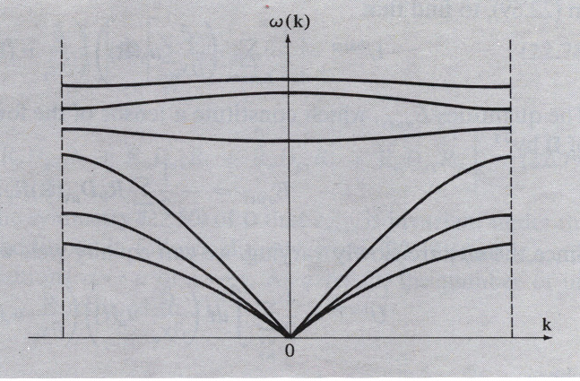
Einstein Model Fails at Low Temp
Einstein’s model also gave a much better fit for medium temperatures, but the temperature dependence near T= 0 still did not agree with experiment. Why?
Taking into account the actual distribution of vibration frequencies in a solid this discrepancy can be accounted for
C_{V}
Notes:
Einstein treated omega as a constant, but we’ve learned it’s not.

Slide 41
Einstein Model Fails at Low Temp
Einstein’s model also gave a much better fit for medium temperatures, but the temperature dependence near T= 0 still did not agree with experiment. Why?
Taking into account the actual distribution of vibration frequencies in a solid this discrepancy can be accounted for
Einstein was aware that getting the frequency of the actual oscillations would be different. He proposed this theory because it was a simple demonstration that QM could solve the specific heat problem.
C_{V}
Notes:
Einstein treated omega as a constant, but we’ve learned it’s not.
Still at bad fit at low temperatures, but way better than the classical model

Slide 42
Incorporating the phonon distribution
Specific heat is still the temperature derivative of energy
C_{v}= dU /dT
Notes:
Pressure hard to control in the real world. However, we often constraint the volume of materials by putting them in stuff.
Drop chemical potential for bosons, comes from the conservation of particles which is not required for bosons.

Slide 43

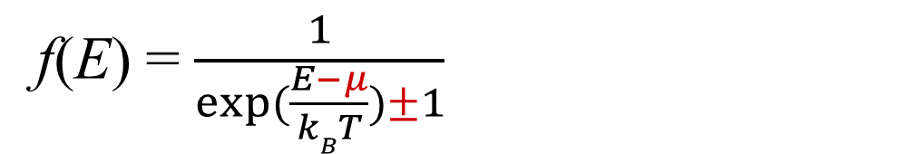
Incorporating the phonon distribution
Specific heat is still the temperature derivative of energy
But now need to include the density of states D(E) (related to number of states N(E))
C_{v}= dU /dT
ω is not a constant
f(E) = $\frac{1}{exp⁡(\frac{E−μ}{kBT})±1}$
Plus for fermions, minus for bosons
Planck distribution
Notes:
Pressure hard to control in the real world. However, we often constraint the volume of materials by putting them in stuff.
Drop chemical potential for bosons, comes from the conservation of particles which is not required for bosons.

Slide 44
Density of Levels/States
(confusing at first, read p. 108-112)
It’s ok if this doesn’t make sense by the end of today. It normally takes some practice before it becomes clear. That’s what homework and tests are for.
Notes:
This density may be different in different directions. Consider this circular room.

Slide 45
Density of Levels/States
(confusing at first, read p. 108-112)
We will often need to know the density of states (DOS) of a system: the number of states per interval of energy at each energy level available to be occupied
Notes:
This density may be different in different directions. Consider this circular room.

Slide 46

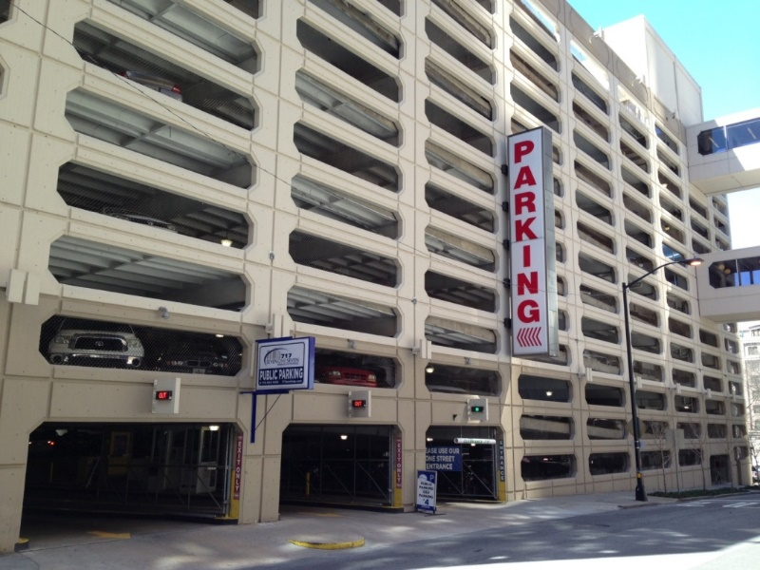
Density of Levels/States
(confusing at first, read p. 108-112)
We will often need to know the density of states (DOS) of a system: the number of states per interval of energy at each energy level available to be occupied
Imagine a multi-level parking lot.
The available number of spots in a particular floor of the parking spot is the density of states for that floor. It doesn't matter if it's occupied or not, just the number available matters for the DOS.
The probability of finding a car in that particular floor is the product of the number of spots available and the fermi probability of occupation.
Thus, each floor (energy level) will have its own DOS and probability.
Karan Mehta, PhD student at Georgia Tech
Notes:
This density may be different in different directions. Consider this circular room.

Slide 47
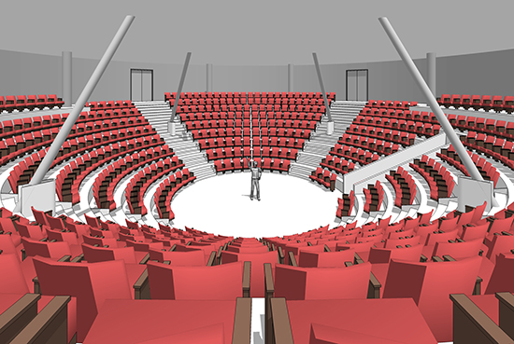
Density of Levels/States
(confusing at first, read p. 108-112)
We will often need to know the density of states (DOS) of a system: the number of states per interval of energy at each energy level available to be occupied
Imagine a multi-level parking lot.
The available number of spots in a particular floor of the parking spot is the density of states for that floor. It doesn't matter if it's occupied or not, just the number available matters for the DOS.
The probability of finding a car in that particular floor is the product of the number of spots available and the fermi probability of occupation.
Thus, each floor (energy level) will have its own DOS and probability.
Karan Mehta, PhD student at Georgia Tech
Notes:
This density may be different in different directions. Consider this circular room.

Slide 48
Density of Levels/States
(confusing at first, read p. 108-112)
We will often need to know the density of states (DOS) of a system: the number of states per interval of energy at each energy level available to be occupied
Imagine a multi-level parking lot.
The available number of spots in a particular floor of the parking spot is the density of states for that floor. It doesn't matter if it's occupied or not, just the number available matters for the DOS.
The probability of finding a car in that particular floor is the product of the number of spots available and the fermi probability of occupation.
Thus, each floor (energy level) will have its own DOS and probability.
Karan Mehta, PhD student at Georgia Tech
k_{y}
k_{x}
Notes:
This density may be different in different directions. Consider this circular room.

Slide 49
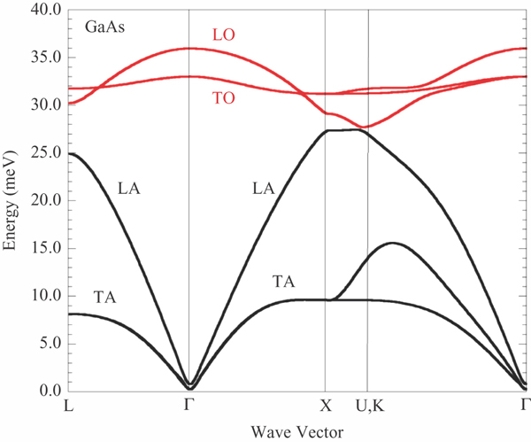
First Intro to Density of Levels/States
(confusing at first, read p. 108-112)
We will often need to know the density of states (DOS) of a system: the number of states per interval of energy at each energy level available to be occupied
Notes:
GaAs
Mention D(E) dE = D(k) dk

Slide 50
First Intro to Density of Levels/States
(confusing at first, read p. 108-112)
We will often need to know the density of states (DOS) of a system: the number of states per interval of energy at each energy level available to be occupied
Figure out by density in k space
Notes:
GaAs
Mention D(E) dE = D(k) dk

Slide 51
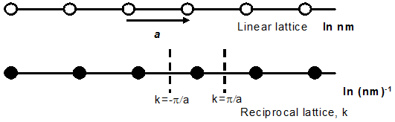
Understanding DOS
(confusing topic, see pages 109-112)
What is the density of points in the reciprocal lattice in one dimension?

Slide 52
Understanding DOS
(confusing topic, see pages 109-112)
What is the density of points in the reciprocal lattice in one dimension?
1 point every 2π/a, so density = #/length = a/2π

Slide 53
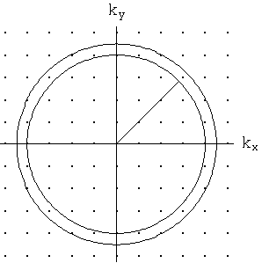
Understanding DOS
(confusing topic, see pages 109-112)
What is the density of points in the reciprocal lattice in one dimension?
1 point every 2π/a, so density = #/length = a/2π
Density of levels * dk = number of points in dk
This density is constant in 1D. How about in 2 or 3?
Notes:
The circles shown are 2D, obviously. Are the number of points inside the same regardless of where a specific thickness is shown? For example, consider an inner radius that is very short version a different inner radius like shown, but with same thickness dk.
No. The number of points depends on that radius. We have to take this into account in higher dimensions.

Slide 54

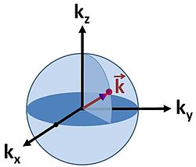
Density of Levels
Allowing ± k, the # of states is
(sometimes only positive values of k, same result):
Total number of states N =
Total volume / volume per state
= (L/2π)³ (4 πK³/3)
= V/8π³ (4 πK³/3)
= VK³/ 6π²
D_{levels} = dN/dk
=VK²/ 2π²
Density of States (with degeneracy)
What degeneracy for phonons?
Times 2 if spin!
Notes:
We can also separate the different directions (longitudinal and 2 transvers) if we want to be more thorough. I’ll show later how we can change the answer to do that. For now, let’s treat them all as degenerate.
Note: sometimes you see the Volume term dropped, for example if finding energy per volume, it would be common to see DOS/V too.
If you are Einstein, you would take a degeneracy of 3 (one longitudinal and 2 transverse in 3D). Better yet, you can separate them into different frequencies, which I’ll show soon. For 2D, you’d only have degeneracy of 2.
For discussion of only positive k values, see extra slide at end.
Running waves allow the possibility of negative k values and allow energy transfer. Standing waves don’t (redundant). I mention this (even though I know it’s confusing) because you will see people using standing waves sometimes in CMP work and it’s useful to know why it’s slightly different and also that you should get the same result.

Slide 55
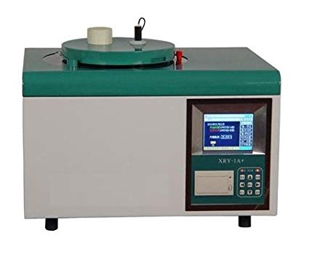
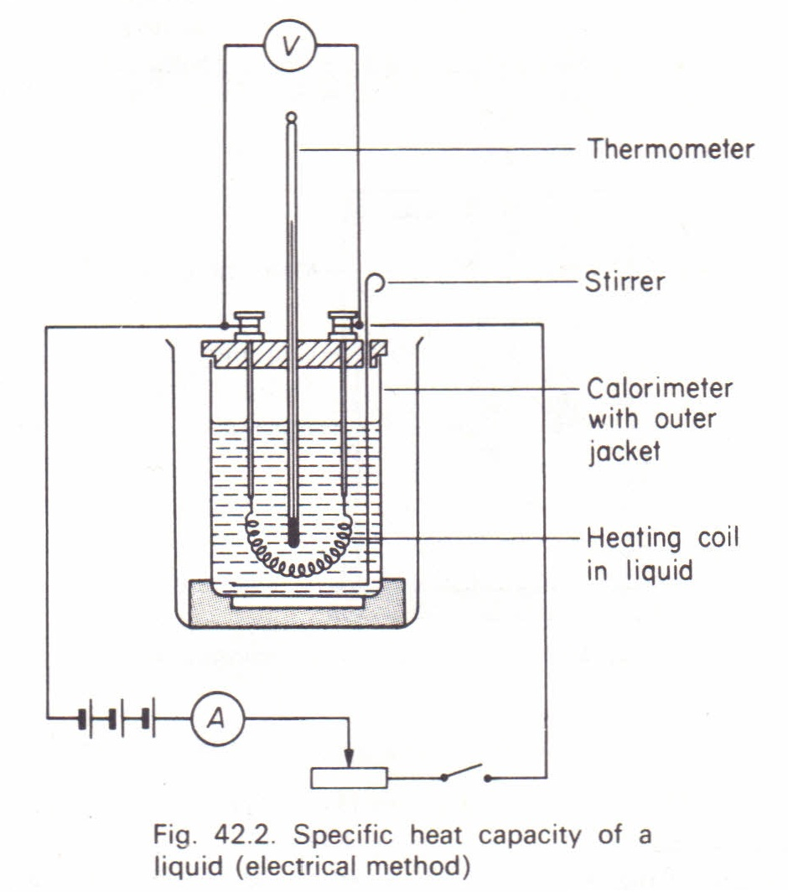
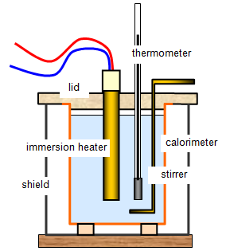
Question: How to measure heat capacity?

Slide 56
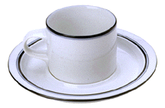

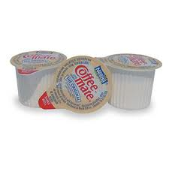
Darin realizes he needs to use the restroom right after he gets a new hot coffee. To have his coffee be as hot as possible a few minutes later, when should Darin add his room temperature coffee creamer?
A. As soon as the coffee is served
B. Just before he drinks it
C. Either; it makes no difference
+
=
Hot black coffee
RT Cream
Warm white coffee
Notes:
A, want a low change in temperature between coffee and room if don’t want the coffee to cool down
Though he probably should have planned to use the bathroom before getting the coffee if he wanted it really hot!

